Slide 1
A DEEP STUDY OF
CHARACTER

Slide 2
TODAY’S READ ALOUD
POPULARITY
By: Adam Bagdasarian
Session One
Notes:
The character of the stories from this collection is names Will. In each story of First French Kiss, he is a different age. In today’s story, he is in the 4th grade. This story is called “Popularity.”
Readers, whenever you start a story, you want to plan your thinkings work. Beginnings of stories, especially shorts stories, come at you quickly. It helps get ready by asking, “What sort of thinking will I be doing?” We have worked in this a little at this point. So quickly, think about what you will focus on as I read.
One way to ALWAYS think is about characters in the story. Their traits, the small details. The smallest character trait can give you insight.
Try this: Pay attention to the small details as I read. Jot them down in your notebook or a Post-It to keep track of your thinking.
I will be paying attention too. Compare your thinking with mine.
Use the read-aloud for this day.

Slide 3
TONIGHT:
READ YOUR NOVEL JOT ON CHARACTER TRAITS
Get lots of reading done. Focus on small, but
important traits.
(Think...Did that almost sneak past me?)

Slide 4
Reader’s Revise Their
Thinking as They Accumulate Evidence.
Session 2
Notes:
Think about your jotting and work you did last night on your book. Also check out the chart from yesterday...
Get out the jots from last night. Put a star next to your character’s strongest traits. Share with your partner. Also, point out, literally, with your finger, the part of the story that you get that from.
When I first was reading Fat Vampire, I really liked the character of Stephin. He was quirky but seems wise and insightful. But as I read, very bluntly my thoughts about her changed

Slide 5
Today I want to teach you that
IN COMPLICATED STORIES, CHARACTER REVEAL THEMSELVES OVER TIME. READERS, ARE THEREFORE ALERT TO NEW DETAILS AND THEY ARE READY TO RETHINK AND REVISE THEIR FIRST IDEAS IN THE THE FACE OF NEW EVIDENCE.

Slide 6
POPULARITY
By: Adam Bagdasarian
Notes:
Will in Popularity: Readers, let’s try this work with Will in Popularity. Remember at the beginning of the story, we said that Will seemed...bitter.
Reading with a theory about a character in mind is really good. You need to look for evidence of your trait theory. But be willing to change or trash your theory if you need to.
If i think about Will AFTER he becomes popular. Is he still bitter? Or, was he ever?? Was there a personality change or was I seeing a middle trait.
Let’s read: “I wondered what my position in the group might be....... I saw myself triumphant.”
Doesn’t he seem kind of different. I was reading with “bitter” in mind, but that is changing. HE is changing across the story.
I mean...think about life. People meet me at first...they think I am shy. Or really snobby. Would you say that about me? NO! Because you see me in a different light and see me 2 hours a day. But really...if you were to meet me at a party...at first..you would think I was really shy.
We change as people get to know us. See how your character changes as you get to know them and see the different parts of their lives.

Slide 7
TRY IT.
Notes:
YOU TRY IT. Are you far enough in your novel to tell some things about your character? If so, think of a single trait you can name of your character. Is there evidence? Or is your character changing...either in the book or in your perception of them? Jot a thought on a post it or your readers notebook. (Wait) Turn and talk with your partner about a trait your character is holding on to or one that is changing...and the evidence behind it.
Wander through the circle looking for and reminding kids to “show WHERE they got that from.”

Slide 8
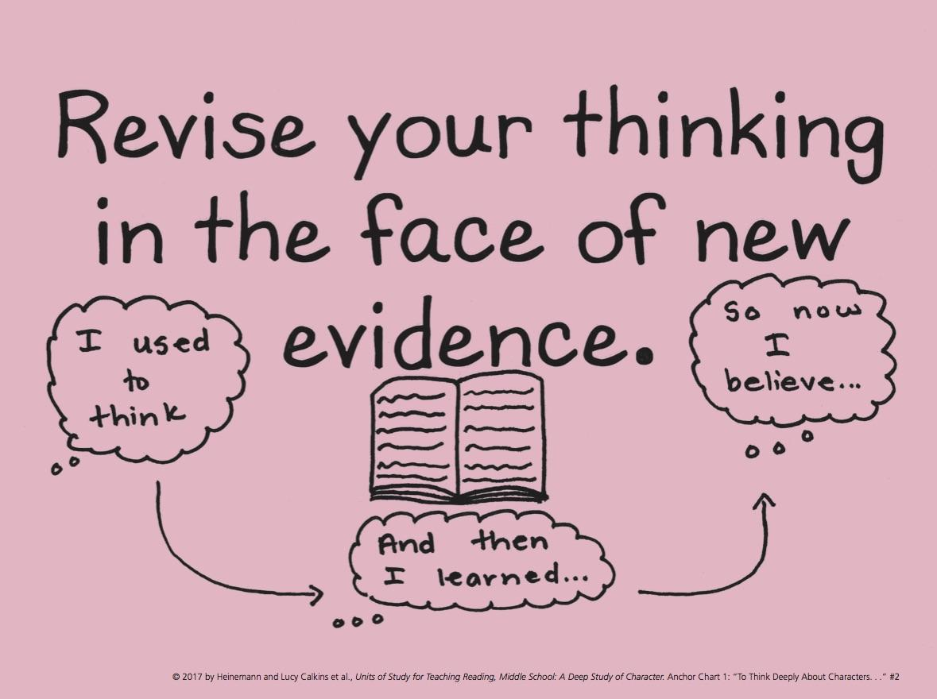
GO READ!
Jot Ideas:
The narrator:
is inconsistent
is complex
has only partial understanding.
has flaws & strengths.
Focus on character traits. What have you learned. Use evidence to support. (Revise think in the face of new evidence!
How, When and Why is my character
growing, changing or changing others?
Notes:
Readers..this would be a great place to stop and spend time in your reader’s notebook. Maybe a cloud chart of “I thought this about my character...and put some evidence.” Then as it changes...add a new cloud.. (Show on chart.)
Maybe do a timeline of traits about your character to trace how they change through the book and keep adding to it through the week!”
Make a plan on what to jot on today. I would suggest looking at the changing traits or evidence of a strong trait for a character. Turn and tell your partner what you will focus on today.

Slide 9
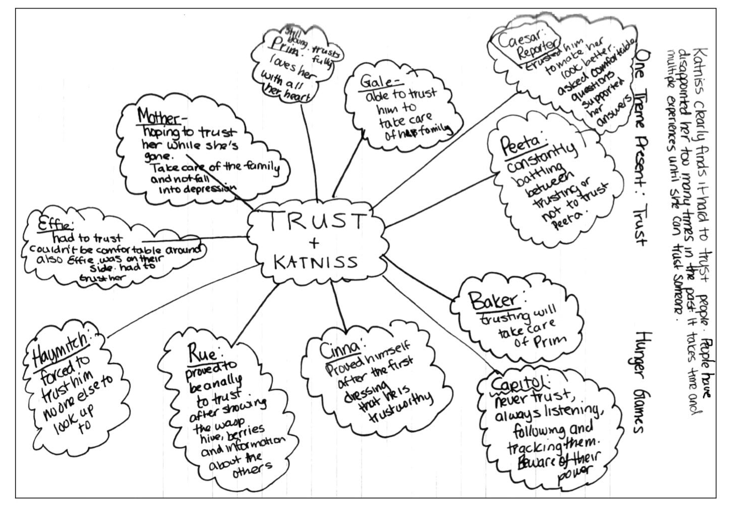
Notes:
Share: I want to stop you and show you an example of a Notebook Page about Katniss. This is a trait of “trust” that the reader is notices and the map is not just a character map...but a map of THAT TRAIT. Think about this as a way to create a page based on the trait you have found over and over again.

Slide 10
Notes:
Share: Here is a notebook page where the traits DO change. Percy goes from feeling like a failure to feeling powerful. So the reader notices this and notes it.

Slide 11
Notes:
Skipping Session 3 for 2017. I already did it. I like the graphic on p 32 of UOS. Add for 2018.

Slide 12
Perceptive Readers Acknowledge the Parts of a Character that Are Less Likeable.
Session 4
Notes:
Anyone here have a brother, sister, friend -even- that is slightly...um...annoying. You pick on them, tease them, etc. BUT heaven forbid if anyone ELSE can pick on them? When you care about a person, it is hard to watch people say bad things without getting defensive.
We can be the same way with our characters.

Slide 13
Today I want to teach you that
It’s easy to sympathize with protagonists, or main characters, and want to defend them. Perceptive readers, thought, realize that complex characters (like real people) have parts to them that are less likable.

Slide 14
POPULARITY
By: Adam
Bagdasarian
Notes:
Will in Popularity: So, I have been defending Will. Trying to sympathize with him wanting to be popular. Even though I no longer care about such things...once upon a time...I really did want this too. But maybe I need to look at his behaviors more closely. I will close my eyes and go over the parts of the story with a lens of, “Are there any parts that push me to the other side of Will? His less likeable sides?”
When he says he never wants to spend time with the Allens again...and if he can wish a wish ..that would be it. It is disloyal, repulsive almost. But then again...I mean...maybe they ARE annoying? Am I just defending Will...?”

Slide 15
Notes:
Any traits show up that shocked you from either character? I hear some of you say that even when Malfoy was alone and down for the count..Harry was merciless. I agree. And some of my experts in HP noted that that spell, Sectumsempra is NOT a spell...it is a deadly curse. It makes me want to reread to see what I missed in my loveable Harry.

Slide 16
Notes:
Now you try this out. I will show you a scene from Harry Potter and the Half-Blood Prince. Harry is a likeable, unsung hero. A kind compassionate boy. And Malfoy is a bully. But watch this scene.

Slide 17
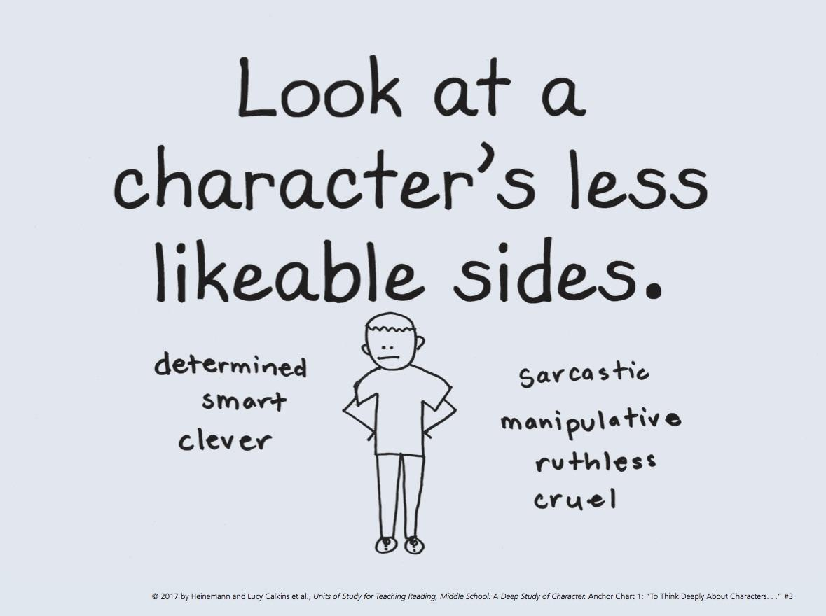
Go Read. Stop and Jot or Write in RN as needed.
Notes:
That feeling of being sort of conflicted over a character isn’t just about Harry or Will. You have that many times in a novel with the main character...or minor character. Push yourself as you read today to find the flaws in your characters and be okay with that...no...mark it and see how the author builds a 3-D character from it.

Slide 18
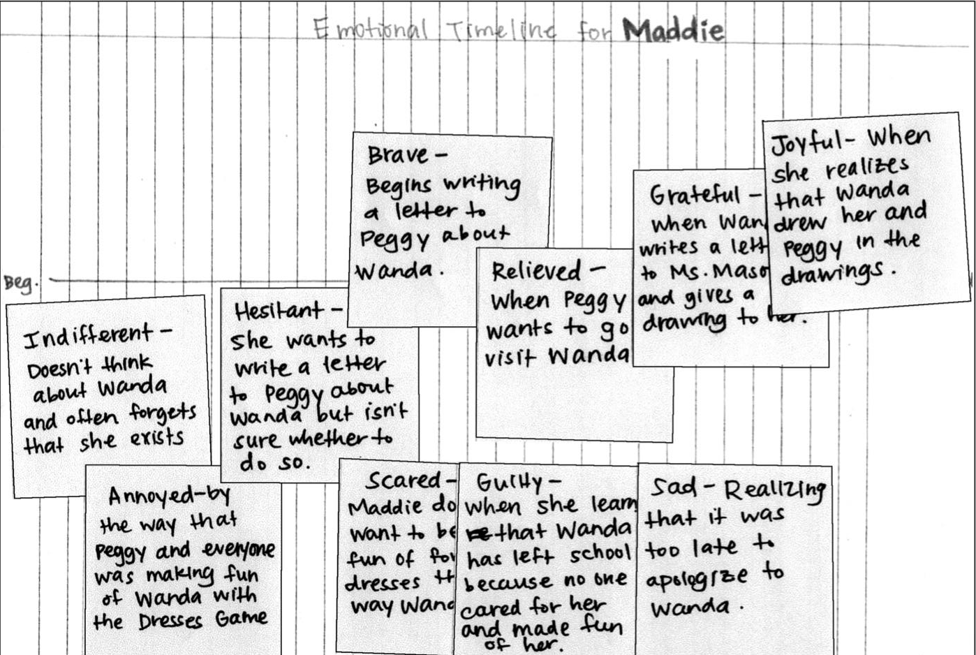
Notes:
MidTeach: I want to show you another way to look at your characters: Something you can all do in your novel is create an emotional timeline. You can trace your characters emotions through the novel, giving evidence along the way. I have an example up there from Greg from Diary of a Wimpy Kid. But you can do this work in all the novels you are reading today.
NOTICE these are jots from several days of reading that then can also work as an extended thinking page.
FYI, at the end of the hour, i will ask you to share your strongest notebook page with your partner. If you want to take a few minutes to scan and see which one you will share, do so. You will also need to think about WHY that is your strongest.

Slide 19
Notes:
Share: Will you take the last few minutes here and share out with your partner what you feel is the strongest of all the notebook pages you have. Be ready to say WHY you feel that way. Go ahead.
Tonight.. I want you to also create a pace. Read for 30 minutes. Yep...AND also pay very close attention to how much you read in thirty.

Slide 20
TODAY’S READ ALOUD
POPULARITY
By: Adam Bagdasarian
Session Five
Notes:
Session 5 Read Aloud: Second half of Popularity.
Turn to your partner and tell them about how your reading went last night...you were to pace yourself in your reading for 30 min. How did that go for you? Turn and Share.
OPTIONAL: “If you read less that 20 pages, stay at the carpet and let’s talk about the next step in your reading.”
Today we are going to continue Popularity. So far we have watched how traits evolve and change. With Will we see less likeable sides and sides that are not always there. But today I want you to think about the idea that SOME TRAITS MATTER MORE THAN OTHERS, BECAUSE THEY INFLUENCE THE STORY.

Slide 21
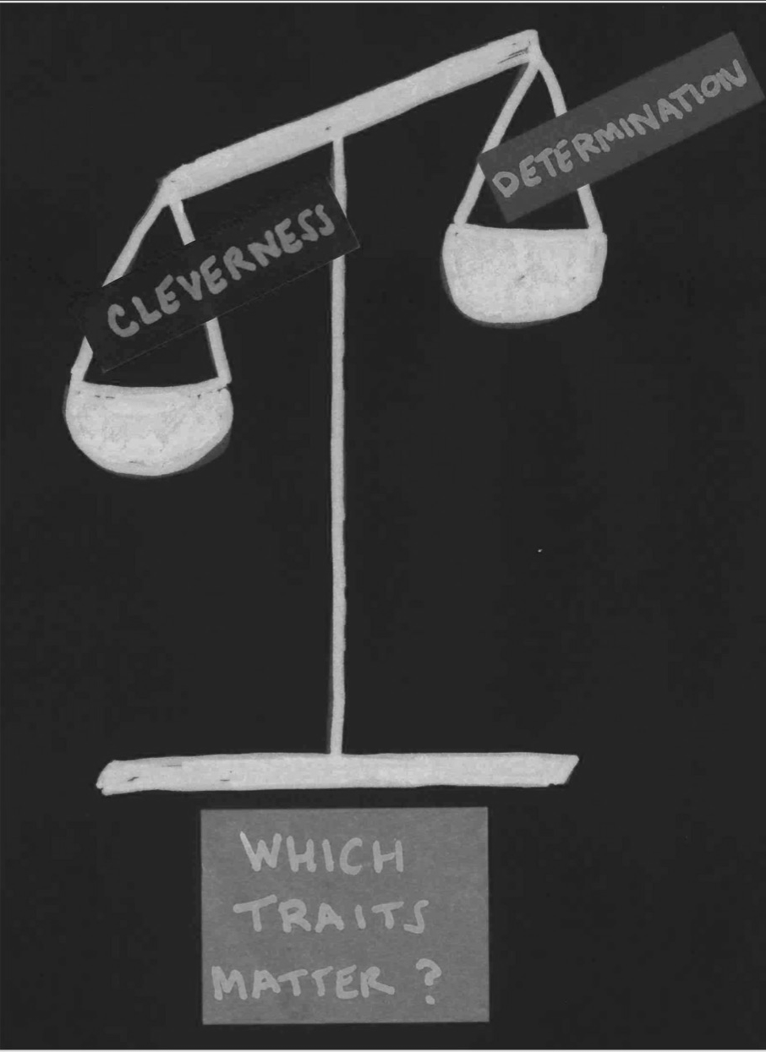
Notes:
If you were to theorize right now, which of these traits would you predict might influence the rest of the plot most?
It seems the determination..that Will will not give up on popularity is going around in conversations. I thought that too. Let’s go back to the story. When we left off, Will was studying the popular crowd. Let’s reread this with the lens of Will’s most important trait being DETERMINATION.
(Read.)
It seems that Will’s cleverness and determination just start jumping off the page, right?
Keep reading...And I am seeing that Will is openly mocking Mitch. That is less determined and moving into ruthless. Now I am seeing that his traits are changing AND he is a little less likeable.
Pause again with “Entire transformation was complete in a matter of months.”
“Well I see some people revising. It seems Will got what he wanted. His motivation and actions overcame his obstacles like we talked about in Writing class.
Let’s finish the story. I know you are wanting to talk about it, so create a jot about that instead. (READ) Wow, what an ending. I love how he brings it back to the 2 Allens. I am thinking about my theories. I bet you are too. JOT some ideas and then discuss them with your partner.” (Prompt for evidence.)

Slide 22
Go Read. Stop and Jot or Write in RN as needed.
Notes:
Go do this with your own novel. If you are far enough along in your novel, think about which trait is starting to become the most important.

Slide 23
Lift the Level of Your Writing about Reading.
Session 6
Notes:
Share with your partner what you jotted about or wrote about last night.
(Walk around.)
It sounds like a lot of you are doing what I do when I am rushed or not in love with a book. You are writing down what you are thinking in the moment. But we need to do better thinking for our books, our partners and ourselves.

Slide 24
Today I want to teach you that
The strongest writing about reading actually lifts the level of your thinking about the book. Whenever you pause in your reading to do some writing, it helps to think about how you want to capture - not your first thinking - but your BEST thinking.

Slide 25
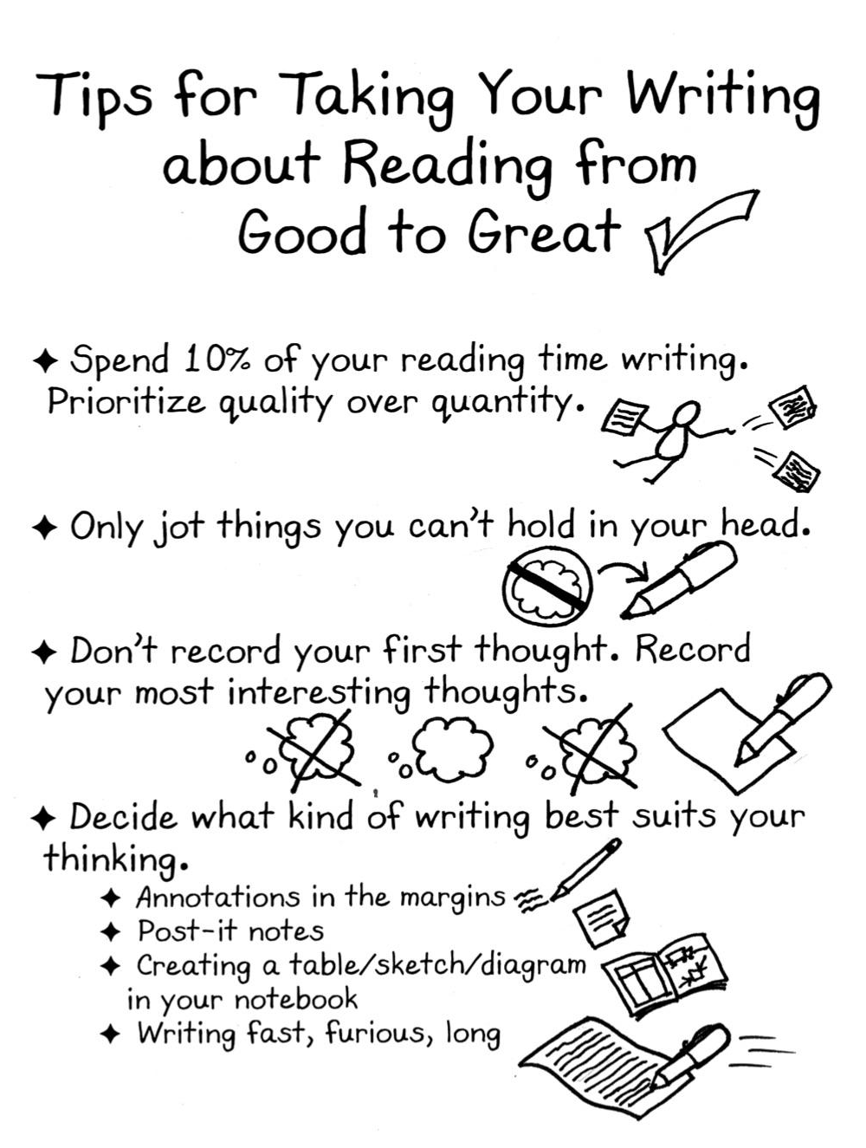
TIPS
Notes:
Our first tip means that you jot less and read more. But it also points to a higher quality jot. If you are going to jot for 3 minutes only...it should be more than Greg Is Wimpy on the post it.
Don’t jot things that you can remember! Think about jotting ideas that need more investigating.
Don’t record your first thought. If you do, just put a jot code down and a page number...that way if that first idea starts growing you can elaborate later, but reference back to the first thought. But don’t spend your time on your initial thought. Let it sit and simmer.
Finally, the last tip is to decide what works best for you. If it is your book, you can mark and underline. If not...post it please. Also you can put the thoughts directly into your notebook if you read with your notebook near you.
And then, again, if you feel like an idea is growing too big for post-its, throw down a Reader's Notebook page.

Slide 26
Go Read. Stop and Jot or Write in RN as needed.
Notes:
Think about what of these tips you have already tried and which ones you need to work on. Write that on a post-it in the front of your book.
Share that with your partner and then head off to read. Remember the goal is to read and have strong writing about your reading. Write things that will lift the level of your reading...not just add ink to paper.
At the end of the hour: Tonight, I want you to read for forty minutes and spend 4 minutes writing about what you read tonight. Bring that in tomorrow. We will do a gallery walk with your homework first thing tomorrow.

Slide 27
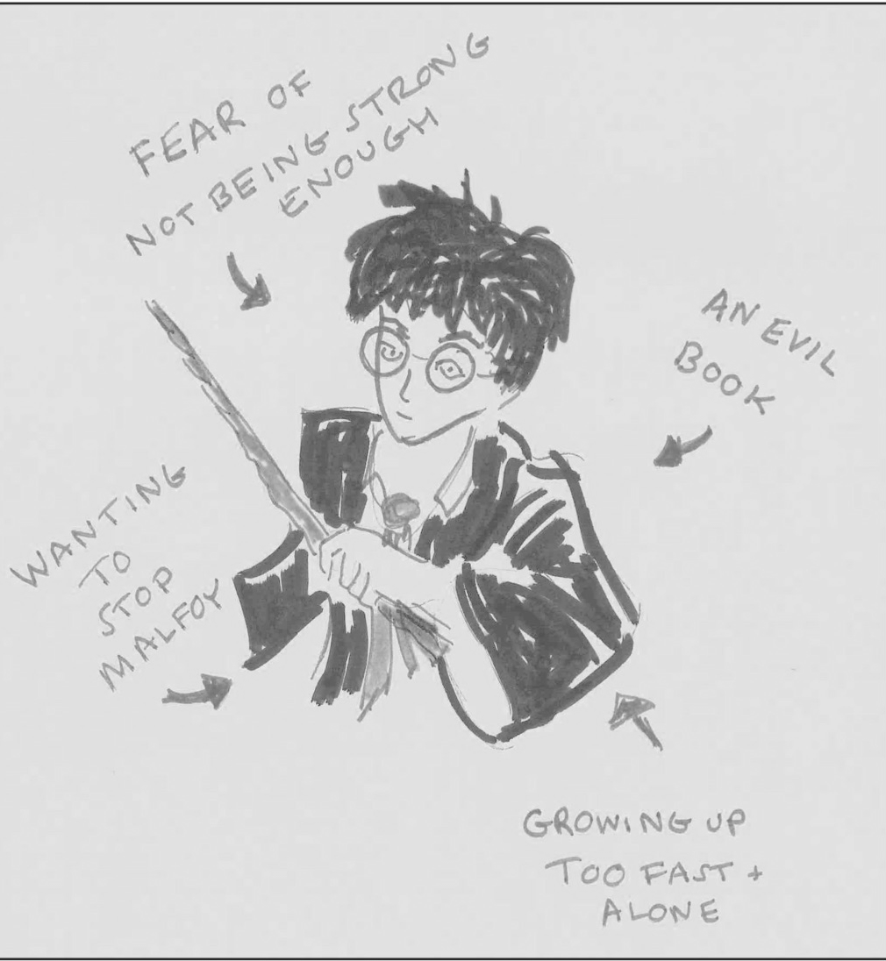
Readers Consider the Pressures Acting on Characters
Session 7
Notes:
Readers, the other day we talked about the less likeable sides of our characters, such as Harry attacking Malfoy with vengeance. A researcher named Pedro Noguera studies teens. He says that when teens at in a problematic way, it is because there are pressures acting on them. When those pressures become unbearable, kids can become destructive. Sort of like we saw with Harry. And with Harry, some of you noted that there were circumstances behind Harry’s attack. He was protecting other students and that Harry was being influenced by the sorcerous book he was reading.
So we need to see WHY our characters are acting the way they do.

Slide 28
Today I want to teach you that
Characters have reasons for the things they do and the ways they are. It’s helpful for a reader to ask, “What pressures might there be on this characters? Do those pressures help me understand the character’s actions and decisions?”

Slide 29
Will from Popularity
NOT-SO-LIKEABLE TRAIT
RUTHLESS
MEAN-SPIRITED
DISLOYAL
SUPERFICIAL
CRUEL
Notes:
Reread the part “I heard laughter and felt the heat of the spotlight on me...more new friends than I knew what to do with”
So. Yes, he is ruthless and cruel. But let’s pull back here. What pressures led to this trait. What is driving him to act this way?
Turn and talk.
The pressure to be popular and liked seems to be going around. I mean..that is a big pressure. And it seems like he is at a school where only the popular kids count. They are the only ones having fun.
Some mentioned loneliness. Some mentioned that he was being picked on and attacked and he was retaliating.

Slide 30
Notes:
We can do this in our own lives. Think to yourself about a trait you have or a time you behaved badly. (Think) Were there pressures exerted on you that caused you to act that way? If you feel comfortable doing so, turn and share with some people around you.
So for better or for worse, we are shaped by the pressures around us. So are characters in strong writing.

Slide 31
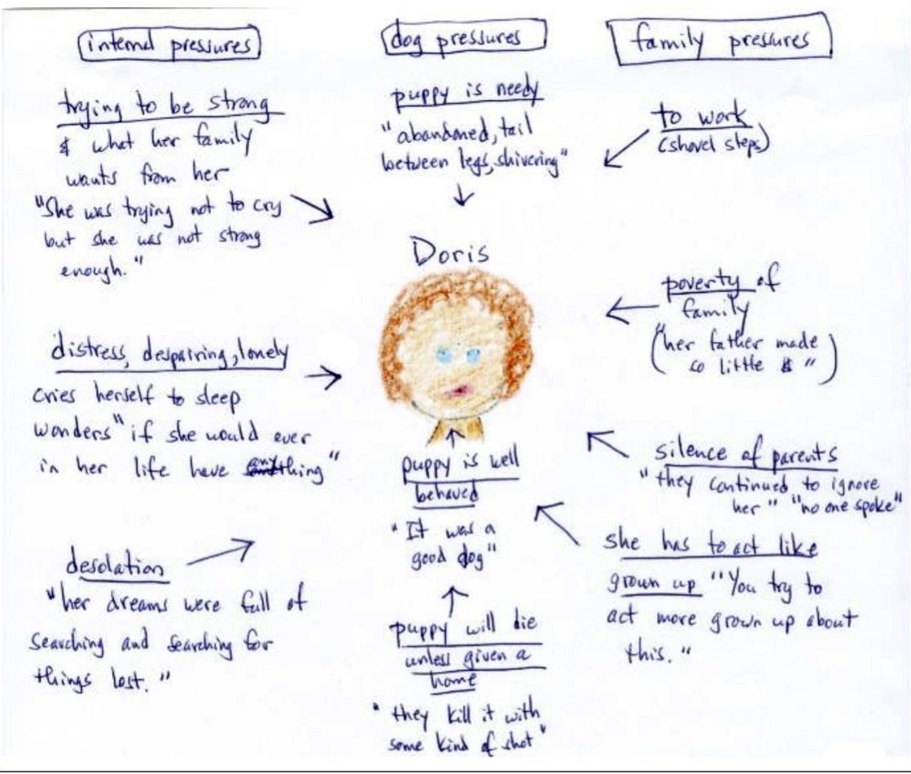
Notes:
As you go off today, maybe you can stop and use time in class to create a pressure map of your character. Think about what is pushing against them. Make a plan, check in with your partner, read, jot and stop to write longer if you feel it.

Slide 32
Go Read. Stop and Jot or Write in RN as needed.
Notes:
Put up for the reading time.

Slide 33
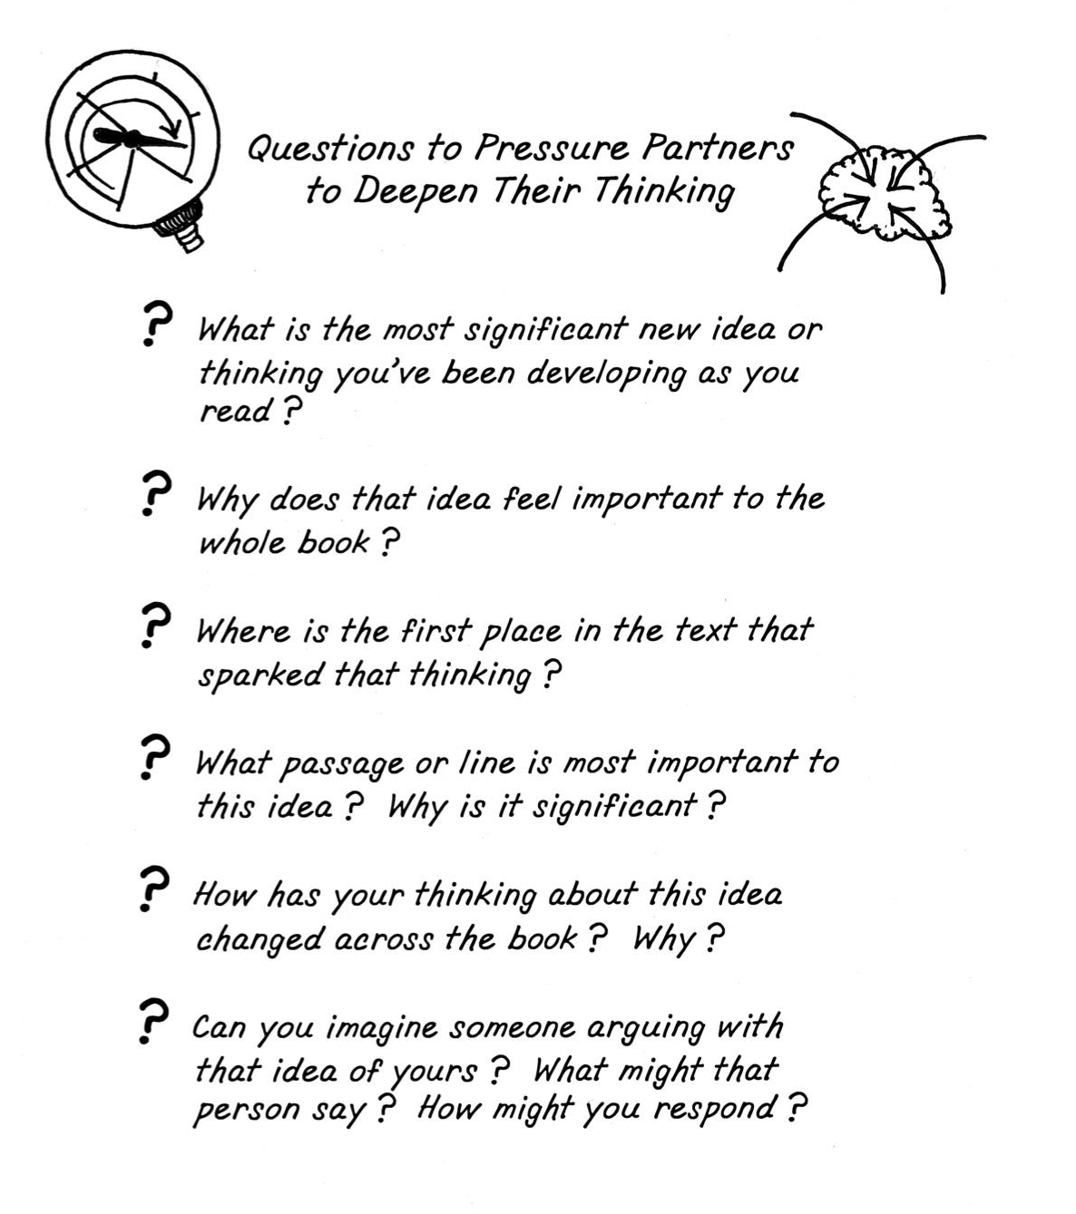
Notes:
One thing we started to talk about a week ago was talking to your partner. I want to stop you here and have you talk with your partner. Like...really talk. Your partner is someone who is going to help support you but also challenge your answers and thinking. So, I have on the board some questions you can as to pressure your partner into thinking more deeply about their novels. Give one or two of these a try now. Make a comment about the lens you were reading with...maybe that your character is not as likeable as you thought...Then your partner can respond with one of these challenging questions.
It may feel awkward at first...but trust me.

Slide 34
Readers Reflect on
Their Novels and
Their Reading Lives.
When you end this book, pick one of these to spend a RN page on.
Session 8
Notes:
Short Lesson. Time to read and write or for a short day.

Slide 35
Notes:
END OF BEND ONE. IGNORE SNAPE BELOW. HE WILL BE MOVING SOON.

