Slide 1
UNIT ONE: NARRATIVE
BEND TWO: DRAFTING AND REVISING WITH AN EYE TOWARD MEANING

Slide 2
SESSION 6: FROM 2-D TO 3-D
Planning and Writing Scenes by Including Evidence.

Slide 3
Please POST your index card on the ‘Coming Soon’ board.
Notes:
On your way to the meeting area, hang your index card on the Coming Soon board for this hour.
Great job on all your hard work. I want to share some of the ideas happening in this class. (grab some cards.)
Today we get to the best part. We will put the muscle on the bones of our stories. We will bring them to life by drafting!

Slide 4
TODAY I WANT TO TEACH YOU THAT:
SOMETHING FICTION WRITERS KNOW: IT IS NOT ENOUGH TO HAVE GOOD IDEAS FOR STORIES. TO MAKE THE 2-D IDEAS FEEL 3-D, THOSE STORIES NEED TO COME TO LIFE.
FICTION WRITERS CAN MAKE THIS HAPPEN BY ASKING, ’IS THERE EVIDENCE IN MY STORY’S EVENTS? DOES MY WRITING SHOW, NOT TELL?’
AND THEN MAKING SURE THAT THEY STORY-TELL, BIT BY BIT.
Notes:
Today I want to teach you that
SOMETHING FICTION WRITERS KNOW: IT IS NOT ENOUGH TO HAVE GOOD IDEAS FOR STORIES. TO MAKE THE 2-D IDEAS FEEL 3-D, THOSE STORIES NEED TO COME TO LIFE.
FICTION WRITERS CAN MAKE THIS HAPPEN BY ASKING, ’IS THERE EVIDENCE IN MY STORY’S EVENTS? DOES MY WRITING SHOW, NOT TELL?’ AND THEN MAKING SURE THAT THEY STORY-TELL, BIT BY BIT.

Slide 5
SUMMARIZING VS STORYTELLING
Summary: Tells a lot of information really quickly, in not many words. It sums up the action.
Storytelling: Is written in scene. It shows what’s happening, but by bit.
Notes:
To start, remember that there is a difference between summarizing and storytelling. Stories are a balance between them. One not being better than the other. But they must be used in the best way.
Let me read you two examples. (p55 - snake bit)

Slide 6
WRITING IN 3-D:
Is there evidence?
Notes:
One way to do this and create what we call a 3-D story is to think, “Is there evidence?” If there is, then add it. Leave clues....kind of like a criminal that WANTS to be caught.
Let’s look at the class story. Let’s find a part...Now, let me ask myself...is there evidence to this?

Slide 7
Turn and Talk:
Give a summary.
Notes:
I want you to try this out yourselves. WIth your partner, you’re going to give just a summary of one moment of your story. One of two sentences. Leave out details. Go.
Have a student share. Help that student turn their summary into a 3-D story? Work as a class.
Good job, using evidence...dialogue, thinking, feeling and movement. Keep finding places that need this evidence.

Slide 8
Off to work!
It is always a good idea to start drafting in 3-D. Don’t wait until revision. Get evidence in now.
You do not have to draft chronologically. Write scene-by-scene.
Notes:
Link. Along with the thoughts on the board, I want you to remember the personal goals you set for yourself yesterday based on the writing narrative checklist.

Slide 9
HOW TO WRITE
COMPELLING FICTION:
Brainstorm a great story idea (small moments, places, events, issues, struggles, stories you wish existed).
Make your characters come alive (traits, wants, struggles, attitude, relationships).
Test-drive your character in scenes (envision and write actions, feelings, dialogue, setting, point of view).
Plot several versions of your story, aiming to intensify the problem (use arcs, timelines and storyboards).
Draft a 3-D story (story-tell bit-by-bit, include evidence of your characters’ actions, thought and feelings.
Notes:
I added to our chart here on a 3-D stroy. I will leave this up as your write today so that you can check your work and make sure you are hitting these points.

Slide 10
Everyone Pause…
Find times to SUMMARIZE.
Move quickly across space and time.
“Writers explode the moment and shrink a century.”
-Barry Lane
Notes:
SHARE: I want to remind you to not forget the value of a summary. Sometimes we need to move quickly through time and space. I love this quote by Barry Lane on the board.
“Writers explode the moment and shrink a century.”
-Barry Lane

Slide 11
Transitional Phrases:
All of the sudden
And suddenly
Afterward
Meanwhile
…
Notes:
I also have up here a beginning list of those transitional phrases to quickly move us from one place or time to another.
Can you add to this?
Remember that time moves forwards and backwards in a story. It is not always linear. Think about times where characters have memories, flashbacks or when an action is recalled.

Slide 12
HOW TO WRITE COMPELLING
FICTION:
Brainstorm a great story idea (small moments, places, events, issues, struggles, stories you wish existed).
Make your characters come alive (traits, wants, struggles, attitude, relationships).
Test-drive your character in scenes (envision and write actions, feelings, dialogue, setting, point of view).
Plot several versions of your story, aiming to intensify the problem (use arcs, timelines and storyboards).
Draft a 3-D story (story-tell bit-by-bit, include evidence of your characters’ actions, thought and feelings.
Manage space and time (Use summary to quickly move and transitional words and phrases to change time and place).
Notes:
I will add to our Compelling Fiction Chart about managing time and space.

Slide 13
Tonight, play around with transitional words and phrases.
Story-tell or summarize?
Notes:
Good job today.

Slide 14
“First find out what your hero wants, then just follow him.”
-Ray Bradbury
(Fahrenheit 451)

Slide 15
UNIT ONE: NARRATIVE
BEND TWO: DRAFTING AND REVISING WITH AN EYE TOWARD MEANING

Slide 16
Session 7:
Stepping into the Drama of the Story
“Walking in the character’s shoes allows writers to record the story as it happens.”
Notes:
I hope that you are seeing how cool writing fiction can be...you plan, list, sketch and so one and then the story just starts to take on a life of its own. Sometimes if even surprises you, the writer.

Slide 17
TODAY I WANT TO TEACH YOU THAT:
Before writers get going on draft, they think a lot about ways to make a draft into a really good story. But once they’re in the midst of the story, they try to lose themselves in it.
They become the characters, and writing is a bit like drama, happening to them.
Notes:
TODAY I WANT TO TEACH YOU THAT:
Before writers get going on draft, they think a lot about ways to make a draft into a really good story. But once they’re in the midst of the story, they try to lose themselves in it.
They become the characters, and writing is a bit like drama, happening to them.

Slide 18
“It is not enough for a writer to tell us about a person or a place; he must give us the illusion of being the person ourselves...the basic failure in much writing is the failure of the writer’s imagination: he is not with it...not trying hard enough to live from moment to moment in the very skin of his characters.”
-Gerald Brace
The Stuff of Fiction
Notes:
Have you ever been reading a book and suddenly, you become Katniss? You know what she’s thinking and feeling. Our readers, too, can walk into the shoes of our characters if we have already done it first. As you are drafting, you need to live in your character's’ skin. Let’s read the last part of our class story. As I read it, I am going to pretend to be “main character.” p66
Active Engagement: I want your help in continuing to write this story. Put yourself in our character’s skin and walk around a bit. Picture them, What would you do?
(WAIT TIME)
Turn and share with a partner. Okay..let’s choose “PARTNER” to add to the story.

Slide 19
HOW TO WRITE COMPELLING FICTION:
Brainstorm a great story idea (small moments, places, events, issues, struggles, stories you wish existed).
Make your characters come alive (traits, wants, struggles, attitude, relationships).
Test-drive your character in scenes (envision and write actions, feelings, dialogue, setting, point of view).
Plot several versions of your story, aiming to intensify the problem (use arcs, timelines and storyboards).
Draft a 3-D story (story-tell bit-by-bit, include evidence of your characters’ actions, thought and feelings.
Manage space and time (Use summary to quickly move and transitional words and phrases to change time and place).
Become the main character, living through the drama of the story.
Notes:
I will add this to our chart here.

Slide 20
“When I finish [reading] a story or novel, I may be pleased, I may even be impressed, but somewhere in the back of my mind I’m thinking, ‘I can do that’.”
-F. Paul Wilson
Notes:
LINK: Remember as you go off to write, that this drafting is a lot like acting. Become the character in the moment. Move them around, get inside their head and heart. It will make it easier for your reader to do it later. Go.

Slide 21
HOW TO WRITE COMPELLING FICTION:
Brainstorm a great story idea (small moments, places, events, issues, struggles, stories you wish existed).
Make your characters come alive (traits, wants, struggles, attitude, relationships).
Test-drive your character in scenes (envision and write actions, feelings, dialogue, setting, point of view).
Plot several versions of your story, aiming to intensify the problem (use arcs, timelines and storyboards).
Draft a 3-D story (story-tell bit-by-bit, include evidence of your characters’ actions, thought and feelings.
Manage space and time (Use summary to quickly move and transitional words and phrases to change time and place).
Become the main character, living through the drama of the story.
Use paragraphs wisely to move in place and time, to highlight dramatic effect.
Notes:
SHARE: Find a student who is paragraphing as a leap into this. So and So is using paragraphs to move through time and space. But you can also use paragraphing, as I have on the chart here, to create dramatic effect.
Look at Thirteen and a Half do it.
Read: p72
THe last line...”So I didn’t” isn’t part of the dialogue format. It is paragraphed to stand out. You can try this too!

Slide 22
UNIT ONE: NARRATIVE
BEND TWO: DRAFTING AND REVISING WITH AN EYE TOWARD MEANING

Slide 23
SESSION 8:
Studying Published Texts
To Write Leads

Slide 24
Read each other’s drafts!
Notes:
Connection: I see a lot of stories coming together. So I wanted to start today off by reading some of your stories to the class. (Do it!)

Slide 25
TODAY I WANT TO TEACH YOU THAT:
Just when writers are most fired up to – when they have just written their lead-they force themselves to pause. They review what they’ve written, and they revise it. They revise the lead because by doing so, they revise their entire story.
Sometimes they do this with the help of a pro.
Notes:
Today I want to teach you that just when writers are most fired up to – when they have just written their lead-they force themselves to pause. They review what they’ve written, and they revise it. They revise the lead because by doing so, they revise their entire story.
Sometimes they do this with the help of a pro.

Slide 26
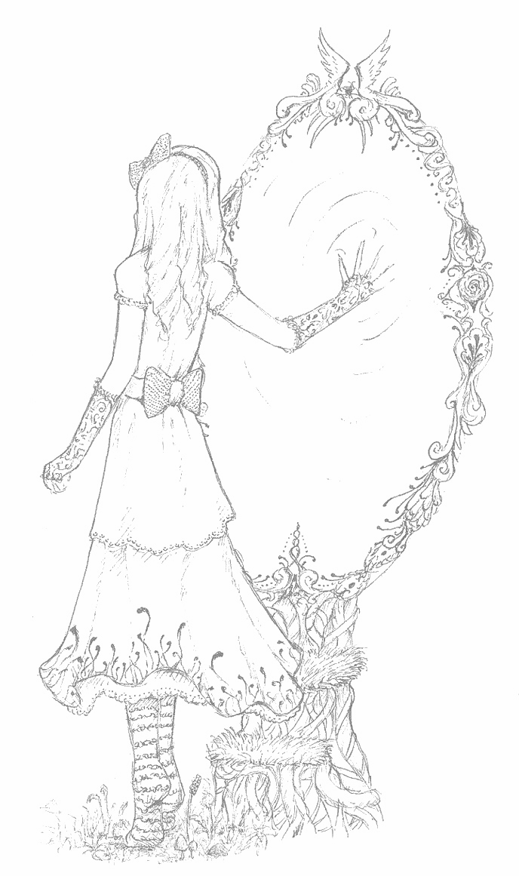
How to create a great lead?
Notes:
One of the most important things we can do as we draft and revise to to think about ushering our readers into the story. We do this with leads. We want to write leads that draw readers into a story. And it can help to study leads of published authors.
Let’s look at Lawrence Yep’s Short Story “Ribbons. It starts like this...
It helps to see that Yep starts with some small actions of the characters, then builds. It also helps to keep the action close to the main event. There Is a tension in this story between The grandmother and Stacy. We get hints of that here.
It is almost like if there is a waterfall in the story, we should start where we can HEAR the falls.

Slide 27
All I knew about Ashley before I went over there yesterday was that until this year she went to private school and now she sits next to me in math. But she asked me over and since I couldn’t think of a good no, I said OK.
Ashley lives near school, so we walked. We didn’t have a lot to talk about on the way, but she didn’t seem to mind. She was telling me that when she grows up she wants to be a veterinarian and a movie star, and travel all over the world very glamorously and live life to the hilt. She asked if I like to live life to the hilt.
“I mostly just hang around,” I admitted.
“But when you get older, and you can do anything,” she whispered, as we began climbing the steep steps up to her huge stone house. “What do you like to imagine?”
I was a little winded from the steps, so I just shrugged.
“Like, I am constantly imagining I can fly,” said Ashley, spreading her arms wide. “Do you ever imagine you’re flying?”
I stopped for breath. “I sometimes imagine I’m in a bakery.”
Notes:
ACTIVE: Here is an excerpt from Thirteen and a Half. I want you to work with a partner to list what you notice about the lead that you could try.
Vail uses a lot of techniques here. Let’s read it again. As you listen this time, pay attention to what part of the lead stands out for you. When I finish reading, turn and point it out to your partner.

Slide 28
Techniques for Crafting Leads:
Some stories begin with a small action set against the backdrop of a setting.
Some stories begin by conveying mood, only afterward does the sequence of actions begin.
Some stories reveal time and space slowly, bit by bit as the character sees or moves in the setting.
Some stories foreshadow a central theme or idea by including a symbol, piece of dialogue or action.
Notes:
LINK:
I will leave this chart up as you work today. I want you to take today to work on your leads. You may choose to study some published author’s leads to help you. Use the ones on your desk, in your book you are reading or our mentor texts.

Slide 29
HOW TO WRITE COMPELLING FICTION:
Brainstorm a great story idea (small moments, places, events, issues, struggles, stories you wish existed).
Make your characters come alive (traits, wants, struggles, attitude, relationships).
Test-drive your character in scenes (envision and write actions, feelings, dialogue, setting, point of view).
Plot several versions of your story, aiming to intensify the problem (use arcs, timelines and storyboards).
Draft a 3-D story (story-tell bit-by-bit, include evidence of your characters’ actions, thought and feelings.
Manage space and time (Use summary to quickly move and transitional words and phrases to change time and place).
Become the main character, living through the drama of the story.
Use paragraphs wisely to move in place and time, to highlight dramatic effect.
Revise the lead (small action, mood, theme, setting, foreshadow).
Research key facts to make the story believable.
Notes:
Share: You guys are doing great things here. I want to add to our growing list of things that can help you write compelling fiction as you are now. Tomorrow we will have a work day tomorrow. You will be the director of your day...What are you going to do to make your piece stranger? Will you study some texts? Return to your checklist and work on those personal goals? research?

Slide 31
WORK DAY!
Work to make your story better.
Choose a goal to improve your work.
Notes:
Session 8.1 Work Day.
Have mentor texts, checklists, etc. for help.

Slide 33
UNIT ONE: NARRATIVE
BEND TWO: DRAFTING AND REVISING WITH AN EYE TOWARD MEANING

Slide 34
SESSION 9:
Grounding Dialogue in Scenes.
Notes:
Connection: I am thinking of a time when my phone went off on a tornado warning alert in the middle of the night. If there were a camcorder on me, it would probably be pretty entertaining. I would be wandering in the dark, talking to myself trying to grab my glasses and bumping into walls.

Slide 35
TODAY I WANT TO TEACH YOU THAT:
You need to be sure that you ‘turn on the lights’ in your stories by grounding your characters in scenes. That is, writers make sure to show characters’ actions as well as the place and time, so that their readers don’t have that disoriented feeling, asking, ‘Wait, where is this? What’s going ?’”
Notes:
TODAY I WANT TO TEACH YOU THAT:
You need to be sure that you ‘turn on the lights’ in your stories by grounding your characters in scenes. That is, writers make sure to show characters’ actions as well as the place and time, so that their readers don’t have that disoriented feeling, asking, ‘Wait, where is this? What’s going ?’”

Slide 36
Scenes…
Are small moments or mini-stories.
Include a clear setting that is woven throughout the moment.
Have characters who are thinking, talking, acting.
Contain a character motivation and obstacle of some sort.
Notes:
Teach: Here is our scenes chart. When you are writing a scene, you might easily get caught in the dialogue. Here is an example of that.
(Use Doc Camera? p86)
Some things work in this scene. Characters are talking and we can tell how they are feeling. But they are floating, they are disoriented like me in a tornado warning in the middle of the night.
The writer needed to revise this scene. They needed to add action, thought, feelings, and a setting. Here is the result (doc camera. p86)
Now our characters are not dark anymore. Drama even starts to happen.

Slide 37
When you revise you’ll reread for all the goals that have become important to you.
Make sure your characters feel real.
Keep an eye on the deeper meaning of your story.
Make sure your readers are not in the dark. (revise if they are!)
Ground your scene by including actions, setting, thoughts and feelings.
Let your characters do things you never expected them to do!
Notes:
Let’s reread the class story. Let’s ask, “Will this make sense to the readers?” If you encounter a passage that might be disorienting, revise it with your partner.
Who would like to share? (Record this.)
So, today we reread the draft, and found places where the reader might be disoriented. So we included a little information about the characters exact actions in the setting. This is what writers do.
LINK: Today, you will continue to draft and revise your stories, shifting between the two. When you revise you’ll reread for all the goals that have become important to you. make sure your characters feel real. Keep an eye on the deeper meaning of your story. Make sure your readers are not in the dark. (revise if they are!)
Ground your scene by including actions, setting, thoughts and feelings.
Let your characters do things you never expected them to do!

Slide 38
Work Day!
House on Fire.
Notes:
This is the mid-teaching point on p90.
I have done this exercise at camps and get-to-know-you meetings. We make a list of things we would take if our house were on fire. We have to think about what is necessary and what is not. As writers, we need to do the same sort of work. We need to keep what is important, and leave what is weighing us down. Sweep through your drafts today and see if you have included what is important, but also gotten rid of stuff that is just fluff. I have a chart I will keep up today to help you have a lense to see what to keep and what to get rid of.

Slide 39
Today...
BE AT THE END OF DRAFTING.
TOMORROW…WE WILL WORK ON ENDINGS.
Notes:
Use today to be at the end of your drafting. We will work on the endings tomorrow. If you need to have homework tonight to get there, then make a point to do that.
(Now show chart on next slide)

Slide 40
House on Fire Test: Check your writing
KEEP WHAT IS IMPORTANT.
Actions, thought and dialogue that move the story
Actions, thoughts and dialogue that develop character.
Descriptions and moments that highlight theme.
Images and metaphors that pop out meaning.
Summaries that explain important information.
CUT WHAT IS NOT.
Actions, thoughts and dialogue that don’t do any work.
Adjectives and frilly language that could be replaces with strong nouns and verbs.
Descriptions that don’t give important information
Distracting details.
Scenes that don’t give important info, or could be summarized.
Summaries that give background information that the reader doesn’t need.

Slide 41
HOW TO WRITE COMPELLING FICTION:
Brainstorm a great story idea (small moments, places, events, issues, struggles, stories you wish existed).
Make your characters come alive (traits, wants, struggles, attitude, relationships).
Test-drive your character in scenes (envision and write actions, feelings, dialogue, setting, point of view).
Plot several versions of your story, aiming to intensify the problem (use arcs, timelines and storyboards).
Draft a 3-D story (story-tell bit-by-bit, include evidence of your characters’ actions, thought and feelings.
Manage space and time (Use summary to quickly move and transitional words and phrases to change time and place).
Become the main character, living through the drama of the story.
Use paragraphs wisely to move in place and time, to highlight dramatic effect.
Revise the lead (small action, mood, theme, setting, foreshadow).
Research key facts to make the story believable.
Get rid of extra stuff that weighs the story down.
Notes:
Before we leave, I want to refer to the chart here. The list is growing!

Slide 43
UNIT ONE: NARRATIVE
BEND TWO: DRAFTING AND REVISING WITH AN EYE TOWARD MEANING

Slide 44
SESSION 10:
WRITING ENDINGS THAT MAKE READERS SWOON.

Slide 45
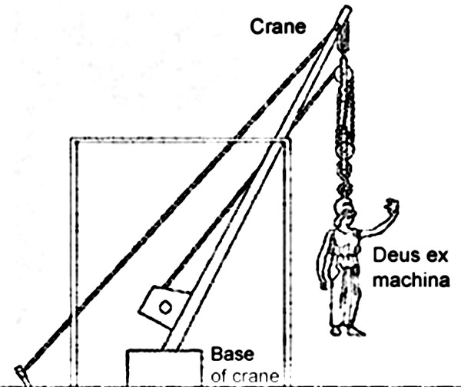
DEUS EX MACHINA
Notes:
Connection: Have you ever been reading a book or playing a videogame..when it just ENDS? It is so disappointing!
In Ancient Greece in the theater, they had this device called a Deus Ex Machina. It meant..Machine of the Gods. When all heck was breaking loose and there was no WAY all this tragedy would be fixed by sundown...in would swoop a crane with an actor on it. Many times this was Apollo. he would wave his magic God wand and fix everything in a matter of a single monologue. Today, we see this term..Deus Ex Machina used in writing, theatre and film still. It refers to an ending that comes to clean...too soon.
We don’t want readers to feel this feeling. We want them to be a part of the ending, to even make them SWOON. So much so, that they count the days until they can read another of our stories.

Slide 46
TODAY I WANT TO TEACH YOU THAT:
writers take their time with endings, weighing and considering and revising until they find one that fits. They know a satisfying ending will tie up loose ends, resolve the unresolved difficulties, and bring home the story’s meaning.
Notes:
Today I want to teach you that: writers take their time with endings, weighing and considering and revising until they find one that fits. They know a satisfying ending will tie up loose ends, resolve the unresolved difficulties, and bring home the story’s meaning.

Slide 47
Principles of Crafting Quality Endings for Fictional Narratives
Keep in mind what your story is REALLY about.
Pay attention to the structure of the story and make sure the ending fits the arc.
Has the character evolved?
How has the plot developed?
Ensure that all loose ends are tied up.
Notes:
Once upon a time, you could just drop a “The End” at the end of a story and that was that. But that was probably when you were 5. Or maybe you, too, dropped in a god or superhero to fix it all up.
Now, we know that life doesn’t work like that. And neither should our stories. Your character must DO something (big or small) at the end of a story to make it end in a way that feels satisfying.
Here are some principles for this. (Chart)

Slide 48
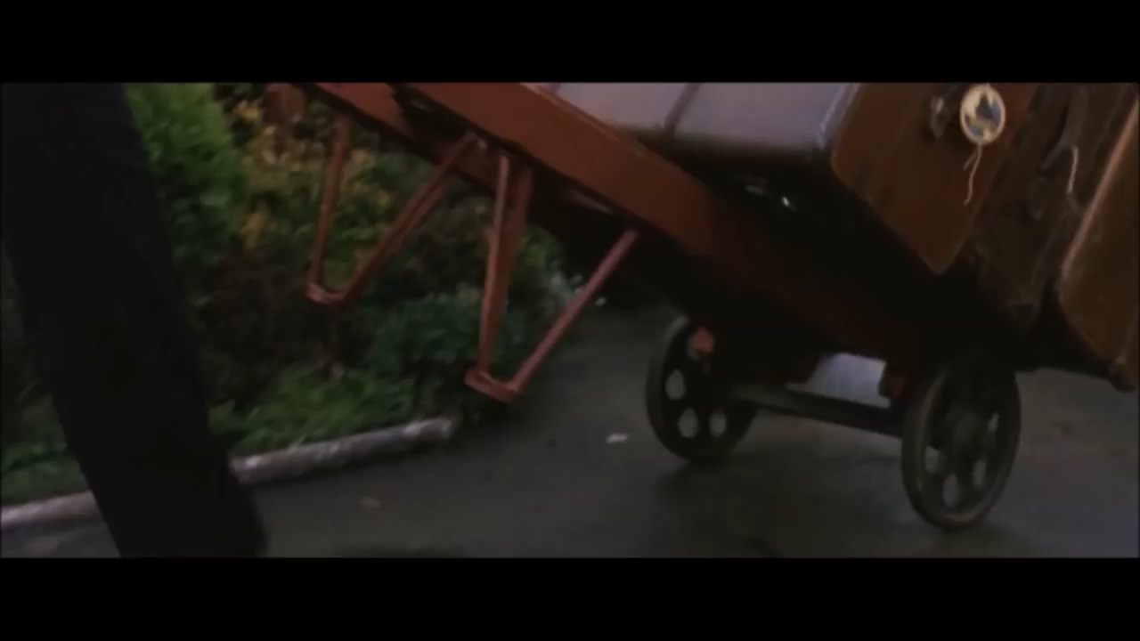
Harry Potter and the Sorcerer’s Stone:
Notes:
Here is an example from The Sorcerer's Stone. As you watch, I want you to think with me about the ending. Notice which strategies are used.
SHOW CLIP
What did you notice? Turn and talk. Then share some ideas you find. “We see the connection between Harry’s family and friends the Power of Love” Which, according to our chart is “what the story is really about.”
We also see a more confident Harry. We also get some knowledge of his parents. This is satisfying, but also sets up the rest of the series as we discover more and more about Harry’s parents.
See how it has a finely crafted ending? I am happy and satisfied, but also wanting to find out what is going to happen in the next story.

Slide 49
Principles of Crafting Quality Endings for Fictional Narratives.
Keep in mind what your story is REALLY about.
Pay attention to the structure of the story and make sure the ending fits the arc.
Has the character evolved?
How has the plot developed?
Ensure that all loose ends are tied up.
Notes:
Let’s try to generate possible endings for our class story. Let’s keep in mind these principles.
(Do it.)

Slide 50
Share: Thirteen and a Half
“Thanks,” she said, as we headed back toward her house. “That was really beautiful, what you said.”
I shrugged.
She held the back door open for me. “Is this the worst playdate of your life?”
“It’s up there,” I admitted.
We waited out front for my mom to pick me up. I sat between my stuff and Ashley. We both tilted our faces up toward the sun. When my mother’s car pulled up and she beeped, I turned to Ashley. “Happy half-birthday,” I said.
“Thanks,” she answered. “Thanks for, you know, being here today.”
I grabbed my stuff and ran down the steps to my mom. I slipped into the car, buckled my seatbelt, and leaned over to get my kiss.
“Did you have a good time?” Mom asked.
I shrugged. I looked out the window. Up the hill, on the front lawn, Ashley was running around in big, loose circles, her arms spread straight out.
Notes:
SHARE:
Some of the close reading work we are doing in reading workshop if very similar to this work we did today. We can use this close reading technique to study our mentor text’s ending. Try this out. Here is the story’s ending. Jot a line from the ending that stands out to you. Share the line. Now what is it exactly that this line does to help the ending? Share with your partner.

Slide 51
HOW TO WRITE COMPELLING FICTION:
Brainstorm a great story idea (small moments, places, events, issues, struggles, stories you wish existed).
Make your characters come alive (traits, wants, struggles, attitude, relationships).
Test-drive your character in scenes (envision and
write actions, feelings, dialogue, setting, point of view).
Plot several versions of your story, aiming to intensify the problem (use arcs, timelines and storyboards).
Draft a 3-D story (story-tell bit-by-bit, include evidence of your characters’ actions, thought and feelings.
Manage space and time (Use summary to quickly
move and transitional words and phrases to change time and place).
Become the main character, living through the drama of the story.
Use paragraphs wisely to move in place and time, to highlight dramatic effect.
Revise the lead (small action, mood, theme, setting, foreshadow).
Research key facts to make the story believable.
Get rid of extra stuff that weighs the story down.
Finish strong.
Notes:
I will be printing off this chart that that is it done. You can put it in your notebook to keep and I will also post it in the room. But we have hopefully done all of this work together.
Tomorrow we will do a work day to catch up and be ready for the next task of creating these awesome stories!

Slide 52
WORK DAY!
Try some close reading of a short story. Pick a section and read it closely. Mark it up and be ready to share.
Notes:
Session 10.1 Work Day.
Have mentor texts, checklists, etc. for help.

